Slide 1
Principles of Management
2023-2024
1

Slide 2
Rules for Case Analysis
and Discussion

Slide 3
Agenda
Case analysis: structure, rules and recommendations;
Case discussion: structure and methodology;
Practical exercises with the methodology of case discussion.

Slide 4
1. Case analysis
The case analysis consists of:
a written report analyzing/describing a company based on a chapter/topic of the theoretical subject (the company is chosen by the Students);
an oral presentation of this analysis to the class.
To complete this work, students will be required to, in groups:
Conduct a written report (Word) about the company reviewed, with a maximum of 2,500 words (cover, table of contents, references and attachments, not included). ​
Prepare a presentation for the class and the professor (e.g., Powerpoint) lasting 15 minutes.

Slide 5
1. Case analysis
The written report, with the case analysis, must be put in Teams by the date and time indicated in the case planning (see slide 30).
All files placed by the group in Teams must be named "IG_ClassXXX_CaseXX";
For instance: IG_ClassM01_Case1A​.

Slide 6
1.1 What is case analysis?
The resolution of a case study presupposes:
Preparation of a written report with an organization's analysis on one or more topics of the syllabus of the course;
Oral presentation about the analysis of the case (Duration = 15 minutes);
Discussion of another group's analysis/report (Duration = 5 minutes).
Note: The analysis should start from the concepts exposed in the theoretical classes and justified with the Information Collected in the sources that must be correctly identified.

Slide 7
Example
The objective of the case is to characterize the strategic management (example) of an SME in the cork sector (example) taking into account the syllabus of the Course Unit;
The main source of information will be an interview and (if any) the Official Company Page on the Internet, and other sources may be used, such as:
Academic studies;
Publications of the company or other entities;
Press Articles;
Etc.

Slide 8
1.2 Evaluation criteria
Written report (15%)
Information collected – correspondence with the requested topic, sources and resources used; Statement on the use of AI tool(s).
Link between class concepts and information collected;
Critical perspective or exceptional and relevant contribution to the work;
Quality of the written report – literacy and style, organization, bibliographic references.
Oral presentation (15%)
Structure, clarity, graphic quality, posture, diction, modeling, respect for time.
Discussion (10%)
Clarity and organization of discussion, posture and correction with colleagues, respect for time, understanding of the topic and contribution to exploring different perspectives.
Notes:
Sobre a correção com os colegas, a pergunta é “quão provável é que a crítica seja entendida como construtiva)

Slide 9
1.3 Sections of the report
(1) Cover
(2) Introduction
(3) Company Presentation
(4) Development
(5) Conclusion
(6) Bibliography and Webgraphy

Slide 10
1.3 Sections of the report (1)
Cover
Title;
Identification of the Course Unit;
Class;
Students;
Academic year;
Professor of practical classes.

Slide 11
1.3 Sections of the report
Introduction (1 page)
Research Object;
Main questions;
Foreshadowing of the following text.
Note: It is expected that the introduction will be about one page long, establish the link with the current and relevant topic and make a reference to the Course Unit.

Slide 12
1.3 Sections of the report (3)
Company Presentation
History;
Products;
Markets;
Size;
Etc.

Slide 13
1.3 Sections of the report
Development
Answering assignment Questions;
It should be presented and related the theoretical body and the empirical material (but they should not have a first part with all the material and another with information about the company, but rather a constant integration of the two);
The importance of framing and relating to the company should not be forgotten (Link between parts of the development section);
The implementation of development does not imply that there is a section called "Development".

Slide 14
1.3 Sections of the report (5)
Conclusion
Synthesis of the key ideas already explained;
Warning: do not include new ideas!
Highlight the contribution of the work to the knowledge on the subject.

Slide 15
1.3 Sections of the report (6)
Bibliography e Webgraphy
With proper criteria!
Do not cite wikipedia, blogs, and other sources of similar characteristics(only in very exceptional situations).

Slide 16
Advice (1)
Being aware of the subjects keeping up with the theoretical classes;
Identify the relevant chapters and concepts and how they can be related;
Think ahead about the structure of the work, in particular the development part;

Slide 17
Advice (2)
Pay attention to deadlines – plan your tasks;
Start from the indicated sources and do new research but without getting lost;
Use the syllabus and relate it to the information collected;
Cohesion of work – attention to the risk of lack of coherence resulting from the division of tasks.

Slide 18
1.4 Bibliography and sources
Concepts:
Main – UC manual and lecture slides;
Other bibliography (less important).
Company Information:
Interview (Identify the interviewee in the report)
Main – Official Company Page;
Other Sources– ex.: News related to the company and theme.

Slide 19
Official company website
Commercial website versus Institutional website;
Exploration of institutional website – Search for sections and documents on (depending on the subject of the case):
Vision, Mission, Values, Code of Conduct;
History;
Products & Markets;
Career;
Diversity & Inclusion;
Ethics and Social Responsibility;
Reports and Accounts and Governance;
(…)

Slide 20
Case Discussion Methodology: “Six Thinking Hats” by Edward De Bono
Nominated for the Nobel Prize in Economics in 2005;
World authority in the field of creative thinking and innovation;
He developed, among others, the Six Thinking Hats Methodology.
Edward de Bono on creative thinking
https://youtu.be/UjSjZOjNIJg
Source: https://www.debonogroup.com/edward-de-bono/

Slide 21
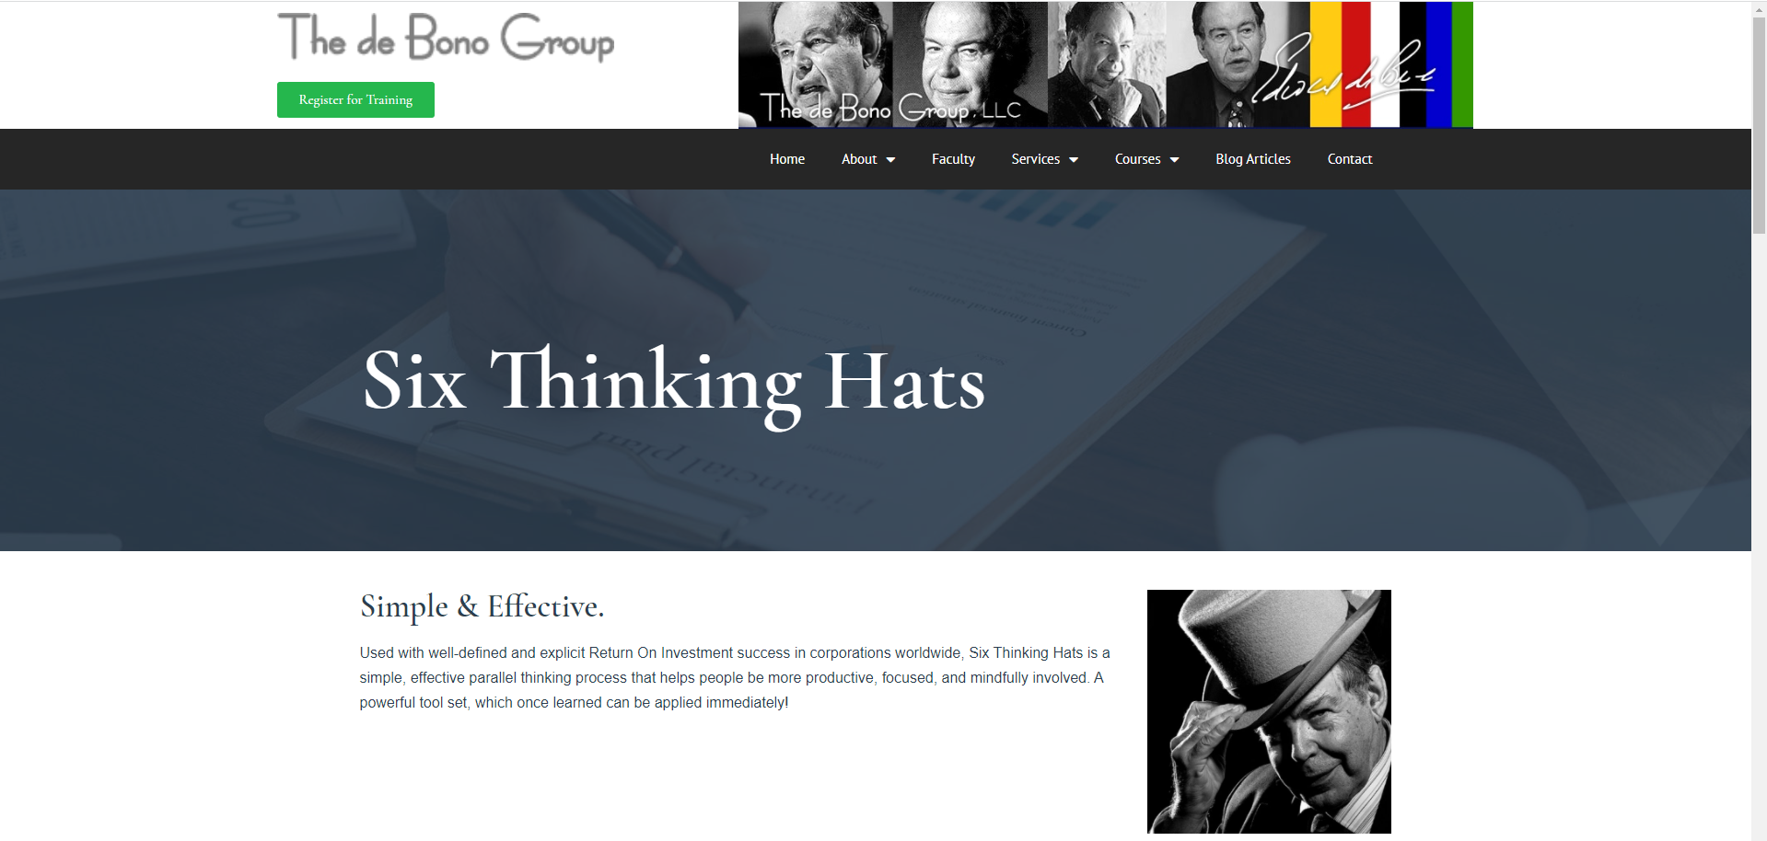
Case Discussion Methodology: “Six Thinking Hats” by Edward De Bono
Thinking with Hats Intro: https://youtu.be/hvChZ4DAghY
Edward de Bono - discusses the Six Thinking Hats®
https://youtu.be/o3ew6h5nHcc
Source: https://www.debonogroup.com/services/core-programs/six-thinking-hats/

Slide 22
2. Case Discussion
Indications for discussion of the case
When you receive the case presentation document you need to discuss, all members of the group should read it carefully and familiarize themselves with the company and its website;
Then, it is suggested that the group meets to analyze and prepare the discussion document of the case together. To do this, they should promote a conversation about the case, using the principles of the Six Thinking Hats methodology®. Wearing one hat at a time, everyone in the group should contribute to the conversation. One of the members of the group, previously chosen, must use the Blue Hat, that is, be the moderator of the discussion. Their role is to ensure that only one hat is worn at a time, and that the members of the group stick to that style of thinking.
Source: https://www.debonogroup.com/services/core-programs/six-thinking-hats/

Slide 23
2. Case Discussion
Indications for discussion of the case
After wearing each hat, they should record the findings of your discussion, in a document to be presented to the class and the teacher, on the agreed day;
Finally, you should complete your document with an introduction and a conclusion. The introduction should reflect a brief presentation of the case they discussed, and the conclusion should integrate the work developed with the hats.
In the following slides, the various hats are presented, and how they can be used in the discussion of the case. Good job! 😊
Source: https://www.debonogroup.com/services/core-programs/six-thinking-hats/

Slide 24
2. Case Discussion
HAT | DESCRIPTION | HOW TO USE IT IN THE DISCUSSION OF THE CASE
WHITE | The White Hat asks for known or necessary information. "The facts, just the facts." | With this hat they must identify the facts exposed in the work that attest to the application of the concepts to the analyzed company.
YELLOW | The Yellow Hat symbolizes brightness and optimism. Under that umbrella, you explore the positives and look for value and benefit. | With this hat they should identify the aspects that they consider most positive in the case they are analyzing.
BLACK | The Black Hat identifies risks, difficulties, problems – The risk management hat, probably the most powerful hat. It can be a problem, however, if overused. It serves to identify difficulties, but also ways to overcome them. | With this hat they should identify the points that could be improved in the case they are analyzing, such as concepts from the chapter that were not addressed in the analysis of the case, failure to identify initiatives that attest to the connection between the concepts and what the company develops, among others.
Fonte: https://www.debonogroup.com/services/core-programs/six-thinking-hats/

Slide 25
2. Case Discussion
HAT | DESCRIPTION | HOW TO USE IT IN THE DISCUSSION OF THE CASE
RED | The Red Hat asks you to reflect on feelings, hunches, and intuition. By wearing this hat, you can express emotions and feelings and share fears, likes and dislikes. | With this hat they should focus on the communication style of the colleagues who present the work. You can also reflect on some aspect of the case that you have identified with, or that has been particularly significant to your discussion.
GREEN | The Green Hat focuses on creativity; the possibilities, alternatives and new ideas. It is an opportunity to express new concepts and new perceptions. | With this hat they should identify what they would have done differently if they had analyzed the case they are discussing, such as what other perspectives could have been addressed, what alternatives could have been presented in the analysis.
BLUE | The Blue Hat is used to manage the thought process. It is the control mechanism that ensures that the indications of the Six Thinking Hats® are observed. | This hat must be worn by one of the members of the group, who will be the facilitator of the discussion of the case. Their job is to ensure that all members of the group stick to the thinking style of the chosen hat.
Fonte: https://www.debonogroup.com/services/core-programs/six-thinking-hats/

Slide 26
Case planning
Cases | Group to Present | Group to Discuss | Report Deadline (23:59) | Discussion Deadline (12:00) | Presentation Date
Diversity and Inclusion | 1a 1b | 5b 2b | Nov 3 | Nov 9 | Nov 10
Social Responsibility and Ethics + Strategy | 2a 2b 3a | 4b 4a 1a | Nov 10 | Nov 16 | Nov 17
Organizational Design + HRM | 4a 5b | 1b 5a | Nov 17 | Nov 23 | Nov 24
HRM + Organizational Design | 5a 4b | 3a 2a | Dec 8 | Dec 14 | Dec 15
Delays in the delivery of works will be penalized by 1 value per hour of delay, up to a maximum of two hours. Works that are more than two hours late are not accepted.
Notes:
https://www.classtools.net/random-group-generator/

Slide 27
Groups
1a
João Pedro Ferreira
Miguel Ferreira
Marcelo Sousa
Vicente Costa
To discuss 2a
1b
Diana da Silva Ribeiro
Aidan Thomas Fourie
Ariana Petim
To discuss 4a
2a
Joana Lopes
Maria Santos
Maria Figueiredo
Sofia Silva
To discuss 4b
2b
Floresbela Pinto
Henrique Mendonça
Pedro Bulha
Gonçalo Oliveira
To discuss 1b
3a
Miguel Medeiros Gomes
Pedro Silva Filipe
Raul Vasconcelos da Silva
Dmitri Zaev
To discuss 5a
4a
Francisco Santos
Ruslana Palkevych
Vasco Borges
To discuss 2b
4b
Dircia Ximenes
Daniyar Myrzashev
Deolize Neto
To discuss 2a
5a
Eduardo H Canarias
Gonçalo Alves
Vicente Rogado
Guilherme Da Cunha
To discuss 5b
5b
Alexandre Crihana
Francisco Gervásio
João de Sousa Eiró
Lea Liu Wang
To discuss 1a

Slide 28
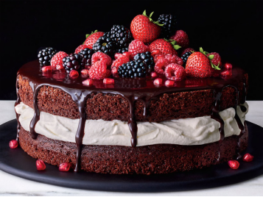
3. Practical exercises
EXERCISE:
THE BEST CHOCOLATE CAKE IN THE WORLD
Fonte: http://nibblesworth.com/incredible-luscious-cake/

Slide 29
Exercise 1
Good morning Chefs!
You were selected to prepare the World's Best Chocolate Cake!
Using the methodology of the Six Thinking Hats™ and using one Hat at a time, we will together "cook" the Best Chocolate Cake in the World!
I will be your Blue Hat, that is, the moderator. Let's use one Hat at a time.
To do this, we can think of several aspects:
The Recipe;
The utensils you need;
The ingredients;
The format;
Etc.

Slide 30
HAT | DESCRIPTION | THE BEST CHOCOLATE CAKE
WHITE | The White Hat asks for known or necessary information. "The facts, just the facts.”
YELLOW | The Yellow Hat symbolizes brightness and optimism. Under that umbrella, you explore the positives and look for value and benefit.
BLACK | The Black Hat identifies risks, difficulties, problems – The risk management hat, probably the most powerful hat. It can be a problem, however, if overused. It serves to identify difficulties, but also ways to overcome them.

Slide 31
HAT | DESCRIPTION | THE BEST CHOCOLATE CAKE
RED | The Red Hat asks you to reflect on feelings, hunches, and intuition. By wearing this hat, you can express emotions and feelings and share fears, likes and dislikes.
GREEN | The Green Hat focuses on creativity; the possibilities, alternatives and new ideas. It is an opportunity to express new concepts and new perceptions.
BLUE | The Blue Hat is used to manage the thought process. It is the control mechanism that ensures that the indications of the Six Thinking Hats® are observed.

Slide 32
Exercise 2
Good morning Chefs!
And now that we've got the World's Best Chocolate Cake, How are we going to get it to the sweet tooths of this world?
Using the Six Thinking Hats™ methodology and using one Hat at a time, you will meet with your working group and think about how you will market the Best Chocolate Cake in the World! You have to choose a colleague from the group to be your Blue Hat, i.e. the moderator. Don't forget to wear one hat at a time.
To do this, they can think of several aspects:
Where and how they will sell?
Who do you want to sell to? Consumers? Other companies?
Marketing?
Collaborators?
What is your differentiation?
Price?

